Slide 1
STOR 455 Class 18
Read: 4.5
Exercises: 4.13, 15

Slide 2
Example: Pulse Rates
Response Variable:
Y =Active pulse
Predictors:
X₁ = Resting pulse
X₂ = Sex (0=M, 1=F)
Data is stored in Pulse.csv

Slide 3
“Dummy” Predictors
We can code a categorical predictor as (0,1)
How should this be interpreted in a regression?
Example: Y = Active pulse

Slide 4
Quantitative + Indicator Predictors
Example: Y = Active pulse rate
X₁ = Resting pulse rate
X₂ = Sex (0,1)
Estimate Std. Error t value Pr(>|t|)
(Intercept) 8.01600 5.04661 1.588 0.113
Rest 1.16484 0.07511 15.508 <2e-16 Sex 2.32642 1.47471 1.578 0.116
$$\hat{Active}=8.016+1.165Rest+2.326Sex$$
How do we interpret the coefficient of sex?

Slide 5
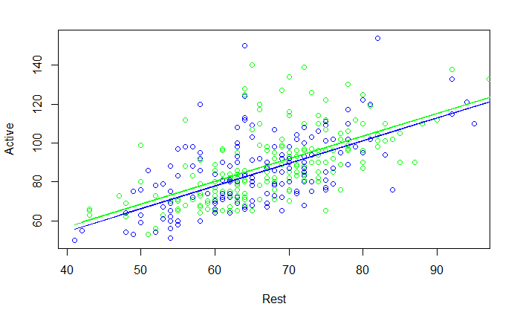
$$\hat{Active}=8.016+1.165Rest+2.326Sex$$
Same slope, different intercepts

Slide 6
Comparing Two Regression Lines (with a multiple regression)
Example:
Y = Active pulse
X₁= Resting pulse X₂=Sex (0,1)
Quantitative
Indicator
Interaction

Slide 7
MTB output to compare two lines
Quantitative + Indicator +Interaction
> modelPint=lm(Active~Rest+Sex+Rest*Sex,data=Pulse)
> summary(modelPint)
Estimate Std. Error t value Pr(>|t|)
(Intercept) 9.43987 7.47902 1.262 0.208
Rest 1.14319 0.11264 10.149 <2e-16 ***
Sex -0.28717 10.22830 -0.028 0.978
Rest:Sex 0.03907 0.15130 0.258 0.796
---
Residual standard error: 14.17 on 371 degrees of freedom Multiple R-squared: 0.4056, Adjusted R-squared: 0.4008
F-statistic: 84.37 on 3 and 371 DF, p-value: < 2.2e-16
$$\hat{Active}=9.440+1.1432Rest−0.287Sex+0.039Rest∗Sex$$
How does this relate to the two lines?
Substitute Sex=0 and Sex=1

Slide 8
Tests to Compare Two Regression Lines
$$Y=β_{0}+β_{1}X_{1}+β_{2}X_{2}+β_{3}X_{1}X_{2}+ε$$
How do we test just a subset of predictors?
Different slope?
H_{o}: β₃ = 0
H_{a}: β₃ ≠ 0
(t-test)
Different intercept?
H_{o}: β₂ = 0
H_{a}: β₂ ≠ 0
(t-test)
Different lines?
H_{o}: β₂ =β₃ = 0
H_{a}: β₂ ≠ 0 or β₃ ≠ 0
(???)

Slide 9
Nested F-test
$$Active =β_{0}+β1Rest+_{2}Sex+ 3RestSex +ε$$
H₀: β₂=β₃=0
H_{a}: Some β_{i}≠0
Compare mean square for the “extra” variability to the mean square error for the full model.
anova(modelP_Reduced, modelPint)
Analysis of Variance Table
Model 1: Active ~ Rest
Model 2: Active ~ Rest + Sex + Rest * Sex
Res.Df RSS Df Sum of Sq F Pr(>F)
1 373 75050
2 371 74538 2 512.14 1.2746 0.2808

Slide 10
More than Two Categories
Example: (Active pulse)
Try a model to predict Y=Active pulse rates using X=Exercise.
How should the coefficients be interpreted?

Slide 11
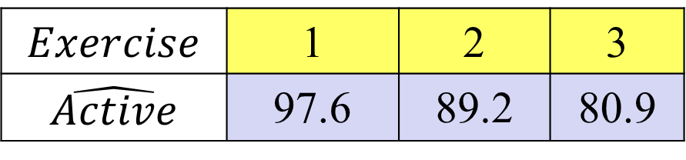
Predicting Active with Exercise
Call:
lm(formula = Active ~ Exercise, data=Pulse)
Coefficients:
Estimate Std. Error t value Pr(>|t|) (Intercept) 105.979 2.878 36.829 < 2e-16
Exercise -8.367 1.224 -6.834 3.37e-11
R-squared: 0.1113, Adjusted R-squared: 0.1089
F-statistic: 46.71 on 1 and 373 DF, p-value: 3.372e-11
$$Exercise$$ | 1 | 2 | 3
$$\hat{Active}$$ | 97.6 | 89.2 | 80.9

Slide 12
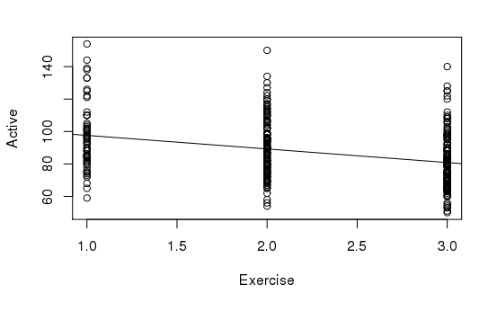

Slide 13
Active Pulse vs. Exercise Categories
> tapply(Pulse$Active, Pulse$Exercise, mean)
1 2 3
96.24242 90.41290 80.29221
Is the “slope” from 1 to 2 the same as from 2 to 3?
Note: Using Exercise as a quantitative predictor forces the “slopes” to be the same.

Slide 14
Dummy Indicators for Multiple Categories
For a categorical predictor with k levels, we use k-1 dummy indicators.
...
R Trick: (To create indicator variables)
Pulse$Moderate=(Pulse$Exercise==2)*1
What happens to Group #k?
Be careful!

Slide 15
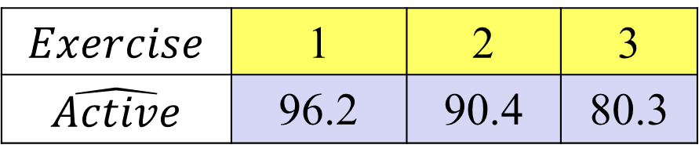
Predicting Active Using Slight and Moderate Exercise Indicators
Call:
lm(formula = Active ~ Slight + Moderate, data = Pulse)
Coefficients:
Estimate Std. Error t value Pr(>|t|) (Intercept) 80.292 1.392 57.670 < 2e-16
Slight 15.950 2.542 6.275 9.74e-10
Moderate 10.121 1.966 5.148 4.27e-07
Multiple R-squared: 0.1144, Adjusted R-squared: 0.1096 F-statistic: 24.02 on 2 and 372 DF, p-value: 1.541e-10
$$Exercise$$ | 1 | 2 | 3
$$\hat{Active}$$ | 96.2 | 90.4 | 80.3

Slide 16
Dummy Indicators for Multiple Categories
For a categorical predictor with k levels, we use k-1 dummy indicators.
...
What happens to Group #k?
Reference group
Constant term is an estimate for Group #k and other coefficients are the differences from it.

Slide 17
Handling Categorical Predictors in R
If a predictor in lm( ) has “text” values, R will automatically create indicators for all but one category.
Using factor( )around a quantitative predictor in lm( )creates the indicators.
modelEX3=lm(Active~factor(Exercise),data=Pulse)

Slide 18
Handling Categorical Predictors in R
> modelEX3=lm(Active~factor(Exercise),data=Pulse)
> summary(modelEX3)
Coefficients:
Estimate Std. Error t value Pr(>|t|)
(Intercept) 96.242 2.127 45.253 < 2e-16 ***
factor(Exercise)2 -5.830 2.539 -2.296 0.0223 *
factor(Exercise)3 -15.950 2.542 -6.275 9.74e-10 ***

Slide 19
Multiple Categories in Regression
With indicator variables for categories we can include quantitative and categorical predictors in the same model
> modelEX4=lm(Active~Rest+factor(Exercise),data=Pulse)
> summary(modelEX4)
Coefficients:
Estimate Std. Error t value Pr(>|t|) (Intercept) 9.25869 6.70517 1.381 0.168
Rest 1.15698 0.08611 13.436 <2e-16
factor(Exercise)2 1.62128 2.15805 0.751 0.453
factor(Exercise)3 -0.51883 2.38266 -0.218 0.828

Slide 20
Multiple Categories in Regression with Interactions
With indicator variables for categories we can include quantitative, categorical, and interaction predictors in the same model
> modelEX4int=lm(Active~Rest+factor(Exercise)+Rest*factor(Exercise),data=Pulse)
> summary(modelEX4int)
Coefficients:
Estimate Std. Error t value Pr(>|t|)
(Intercept) -7.5850 13.1326 -0.578 0.5639
Rest 1.3810 0.1731 7.977 1.91e-14 factor(Exercise)2 28.6009 16.4065 1.743 0.0821
factor(Exercise)3 16.5284 15.7150 1.052 0.2936
Rest:factor(Exercise) -0.3715 0.2240 -1.659 0.0980 .
Rest:factor(Exercise) -0.2273 0.2216 -1.026 0.3056

Slide 21
Model Selection with Categorical and Interaction Predictors
Use each of the four model selection methods discussed in class (AllSubsets, Backwards, Forwards, and Stepwise) and compare the processes and outcomes for the predictor pool:
Rest, Exercise, Hgt, Wgt, Rest & Exercise, Hgt & Exercise, and Wgt & Exercise

